Slide 1


Australian Diabetes Clinical Quality Registry (ADCQR) Results 2025
Add your site details here

Slide 2

You may wish to customise this slide to acknowledge the traditional custodians in your area

Slide 3
ADCQR 2025
Instructions to populate the slides
This slide deck is intended for you to share ADCQR 2025 site report results with your team and to identify areas for Quality Improvement.
It covers the same process and outcome measures as your ADCQR 2025 Site Report.
This interactive template has been partially populated. You may not need all these slides – please remove any slide you don’t need. Feel free to add others as you need, or to delete rows in tables that you don’t have data for.
You will need to add the data from your site report to individual slides. We have added notes in red text to guide you with this process. For some slides, you may need to take a screenshot from your report and add this picture.
There are 2 slide options for lipid medications and missing data. If you are comfortable editing the associated Excel spreadsheet, use slides 14 & 15. If not, use slide 13.
Delete this slide before presenting

Slide 4
ADCQR 2025
Demographics
 | Type 1 (n = x) | Type 2 (n = x)
Age (mean, SD) | Insert mean + SD | Insert mean + SD
Sex (female) | Insert % | Insert %
Diabetes duration (median, IQR) | Insert median, IQR | Insert median, IQR
Aboriginal or Torres Strait Islander | Insert % | Insert %
Australian born | Insert % | Insert %
NDSS registrant | Insert % | Insert %
Please refer to page 7 of the site report

Slide 5
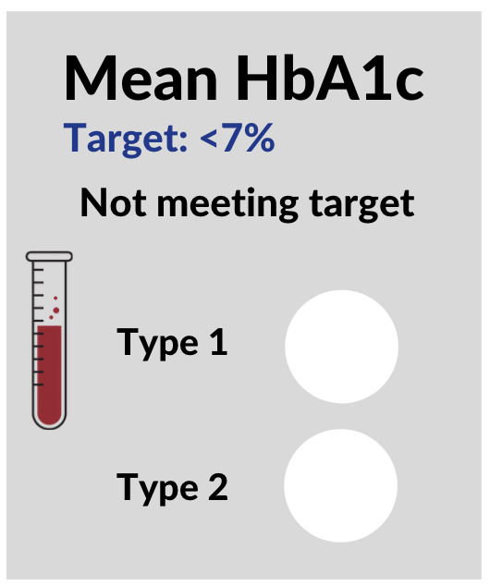
ADCQR 2025
Glycaemic control - Slide 1
Mean HbA1c
≤
 | Our site | Other similar sites
Type 1 | Insert % | Insert %
Type 2 | Insert % | Insert %
Insert %
Insert %
Please refer to page 8 of the site report

Slide 6
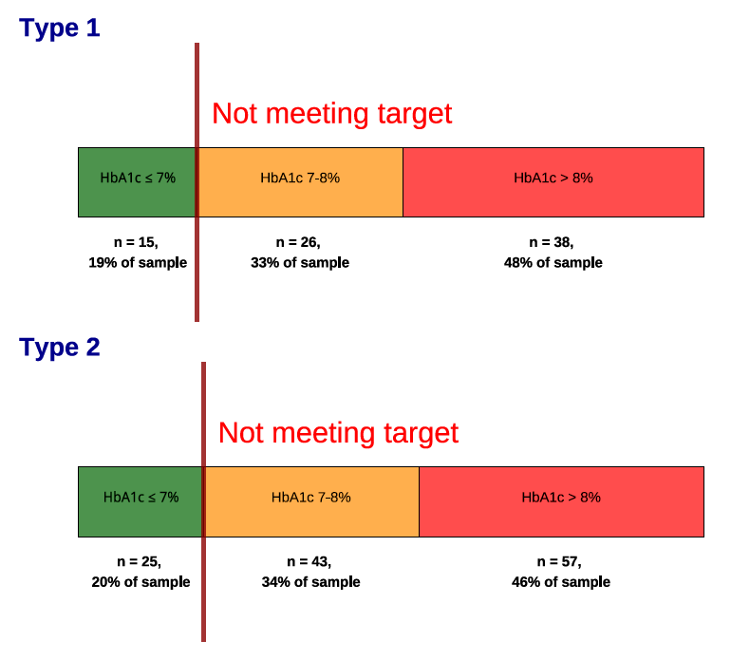
ADCQR 2025
Glycaemic control Slide 2 – HbA1c distribution
Insert screenshot from report that looks similar to this, as shown on page 8.
Delete this example picture and this red text before presenting
EXAMPLE ONLY
Please refer to page 9 of the site report

Slide 7
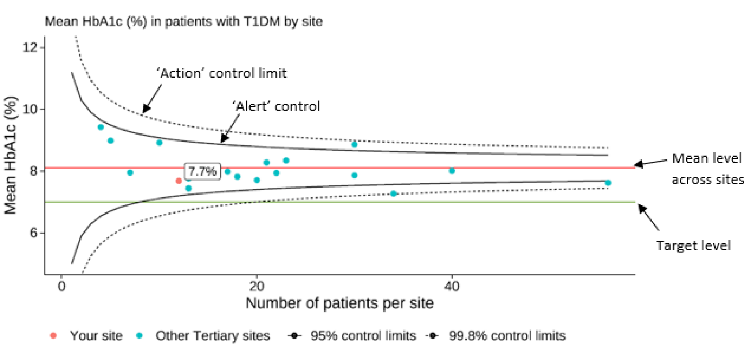
ADCQR 2025
Clinical variation in glycaemic control – T1DM/T2DM
Use T1DM and T2DM risk adjusted funnel plots on page 10 of the site report
Information to interpret funnel plots is in the methods section on page 5
EXAMPLE ONLY
Please refer to page 12 of the site report

Slide 8
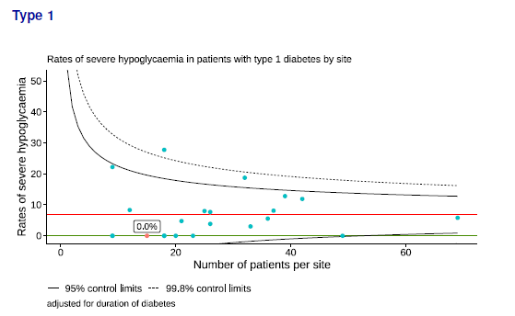
ADCQR 2025
Clinical variation in rates of hypoglycaemia– T1DM/T2DM
Use T1DM and T2DM risk adjusted funnel plots on page 11 of the site report
Information to interpret funnel plots is in the methods section on page 5
EXAMPLE ONLY
Please refer to page 12 of the site report

Slide 9

ADCQR 2025
Blood glucose monitoring
 | Type 1 | Type 2
Flash/CGM monitoring only | Insert % | Insert %
Finger pricking and Flash/CGM | Insert % | Insert %
Finger pricking only | Insert % | Insert %
None | Insert % | Insert %
Please refer to page 13 and 14 of the site report

Slide 10


ADCQR 2025
BMI
Target: < 25kg/m² for all people with diabetes
Percentage not meeting target:
 | Our site | Other similar sites
Type 1 | Insert % | Insert %
Type 2 | Insert % | Insert %
Please refer to page 17 of the site report

Slide 11

ADCQR 2025
Blood pressure
Targets : < 140/90 mmHg in adults with diabetes
< 130/80 mmHg in adults with diabetes and albuminuria/nephropathy
Percentage not meeting target:
Type 1 | Our site | Other similar sites
≥130mmHg | Insert % | Insert %
≥140mmHg | Insert % | Insert %
Type 2 | Our site | Other similar sites
≥130mmHg | Insert % | Insert %
≥140mmHg | Insert % | Insert %
Please refer to page 18 of the site report

Slide 12
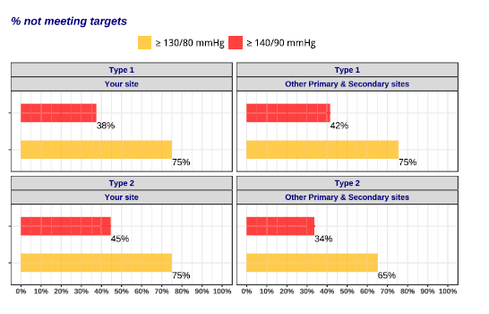
Blood pressure
ADCQR 2025
(Alternative slide)
Targets : < 140/90 mmHg in adults with diabetes
< 130/80 mmHg in adults with diabetes and albuminuria/nephropathy
EXAMPLE ONLY

Slide 13
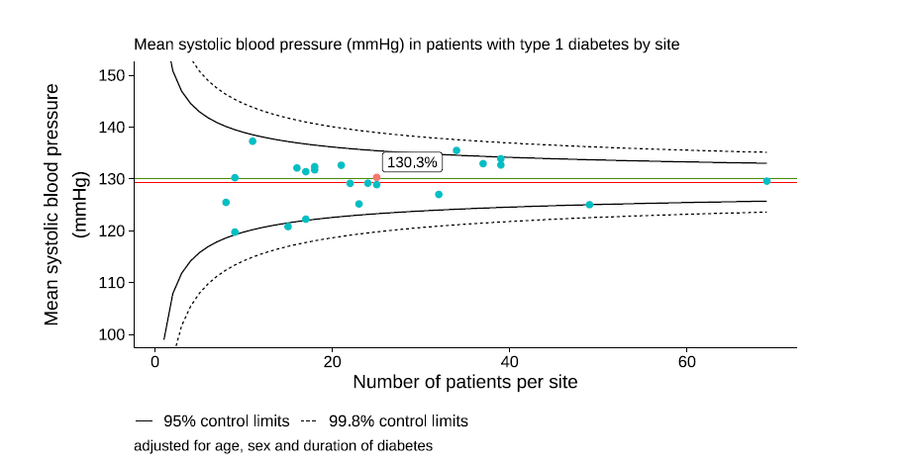
Clinical variation in blood pressure control – T1DM/T2DM
ADCQR 2025
Use T1DM and T2DM risk adjusted funnel plots on page 18 of the site report
Information to interpret funnel plots is in the methods section on page 5
EXAMPLE ONLY
Please refer to page 19 of the site report

Slide 14
ADCQR 2025
Antihypertensive medications
Prescribing and treatment gaps
Prescribing gap (% not on antihypertensive therapy despite
blood pressure ≥ 130/80 mmHg): Type 1: insert %
Type 2: insert %
Treatment gap (% with blood pressure ≥ 130/80 mmHg, despite
using antihypertensive therapy): Type 1: insert %
Type 2: insert %
Please refer to page 20 and 21 of the site report

Slide 15

ADCQR 2025
Smoking
Target: 0% smoking
Percentage current smokers:
 | Our site | Other similar sites
Type 1 | Insert % | Insert %
Type 2 | Insert % | Insert %
Please refer to page 22 of the site report

Slide 16

ADCQR 2025
Lipids
Targets: Total cholesterol: <4 mmol/L, LDL: <2 mmol/L, HDL: ≥1 mmol/L,
Non-HDL cholesterol: <2.5 mmol/L, Triglycerides: <2 mmol/L
Percentage not meeting targets:
 |  | Our site
Type 1 | Total cholesterol (>= 4mmol/L) | Insert %
 | LDL cholesterol (>=2 mmol/L) | Insert %
 | HDL cholesterol (<1 mmol/L) | Insert %
 | Non-HDL cholesterol (>= 2.5 mmol/L) | Insert %
 | Triglycerides (>= 2mmol/L) | Insert %
Type 2 | Total cholesterol (>= 4mmol/L) | Insert %
 | LDL cholesterol (>=2 mmol/L) | Insert %
 | HDL cholesterol (<1 mmol/L) | Insert %
 | Non-HDL cholesterol (>= 2.5 mmol/L) | Insert %
 | Triglycerides (>= 2mmol/L) | Insert %
Please refer to page 23 and 24 of the site report

Slide 17
Lipids data & medications – Type 1
ADCQR 2025
Please refer to page 26 of the site report
Lipids measured
Type 1: insert %
Prescribing gap (% not on lipid-lowering therapy despite total cholesterol ≥4 mmol/L)
Treatment gap (% not meeting target total
cholesterol, despite using lipid-lowering therapy)
These figures require you to edit the associated Excel spreadsheets:
1. Right click figure
2. Choose edit data.
3. Enter your data.
4. Delete this text

Slide 18
Lipids data & medications – Type 2
ADCQR 2025
Please refer to page 27 of the site report
Lipids measured
Type 2: insert %
Prescribing gap (% not on lipid-lowering therapy despite total cholesterol ≥4 mmol/L)
Treatment gap (% not meeting target total
cholesterol, despite using lipid-lowering therapy)
These figures require you to edit the associated Excel spreadsheets:
1. Right click figure
2. Choose edit data.
3. Enter your data.
4. Delete this text

Slide 19
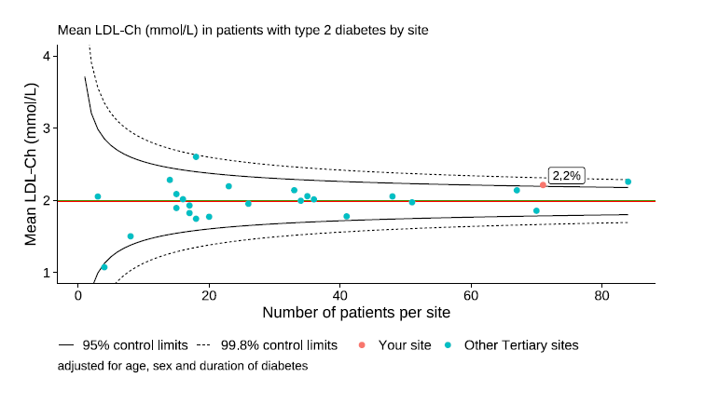
Clinical variation in lipids control
ADCQR 2025
Use T1DM and T2DM risk adjusted funnel plots on page 24 of the site report
Information to interpret funnel plots is in the methods section on page 5
EXAMPLE ONLY
Please refer to page 25 of the site report

Slide 20
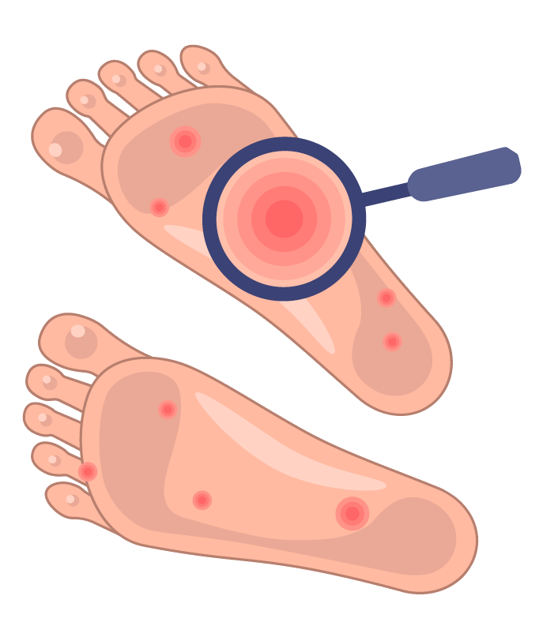
ADCQR 2025
Foot complications – Type 1
Target: Identify high risk foot, active foot problems, and prevent non-traumatic amputations
 |  | Our site | Other similar sites
Type 1 | Foot check by health professional | Insert % | Insert %
 | Peripheral neuropathy | Insert % | Insert %
 | Peripheral vascular disease | Insert % | Insert %
 | Foot ulceration | Insert % | Insert %
 | Lower limb amputation | Insert % | Insert %
Please refer to page 29 of the site report

Slide 21
ADCQR 2025
Foot complications – Type 2
Target: Identify high risk foot, active foot problems, and prevent non-traumatic amputations
 |  | Our site | Other similar sites
Type 2 | Foot check by health professional | Insert % | Insert %
 | Peripheral neuropathy | Insert % | Insert %
 | Peripheral vascular disease | Insert % | Insert %
 | Foot ulceration | Insert % | Insert %
 | Lower limb amputation | Insert % | Insert %
Please refer to page 30 of the site report

Slide 22

ADCQR 2025
Eyecare – Type 1
Target: Assessment within 5 years of diagnosis, then annually
 |  | Our site | Other similar sites
Type 1 | Attended optometrist/ophthalmologist | Insert % | Insert %
 | Retinopathy | Insert % | Insert %
 | Treatment for retinopathy | Insert % | Insert %
 | Right or left cataract | Insert % | Insert %
 | Blindness | Insert % | Insert %
Please refer to page 31 of the site report

Slide 23
ADCQR 2025
Eyecare – Type 2
Target: Assessment at diagnosis, then annually
 |  | Our site | Other similar sites
Type 2 | Attended optometrist/ophthalmologist | Insert % | Insert %
 | Retinopathy | Insert % | Insert %
 | Treatment for retinopathy | Insert % | Insert %
 | Right or left cataract | Insert % | Insert %
 | Blindness | Insert % | Insert %
Please refer to page 32 of the site report

Slide 24
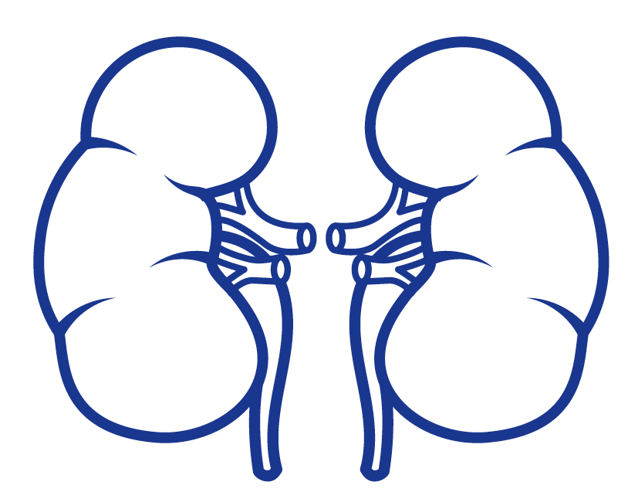
ADCQR 2025
Kidney disease – Type 1
Target: Identify and treat individuals with nephropathy
 |  | Our site | Other similar sites
Type 1 | Moderately increased albuminuria | Insert % | Insert %
 | Severely increased albuminuria | Insert % | Insert %
 | eGFR <60 mL/min/1.73m² | Insert % | Insert %
 | End stage kidney disease | Insert % | Insert %
Please refer to page 33 of the site report

Slide 25
ADCQR 2025
Kidney disease – Type 2
Target: Identify and treat individuals with nephropathy
 |  | Our site | Other similar sites
Type 2 | Moderately increased albuminuria | Insert % | Insert %
 | Severely increased albuminuria | Insert % | Insert %
 | eGFR <60 mL/min/1.73m² | Insert % | Insert %
 | End stage kidney disease | Insert % | Insert %
Please refer to page 34 of the site report

Slide 26
ADCQR 2025
Complications in the last 12 months – Type 1
 | Our site | Other similar sites
Acute complications
Diabetic ketoacidosis | Insert % | Insert %
Hyperosmolar hyperglycaemic state | Insert % | Insert %
Severe hypoglycaemia | Insert % | Insert %
Impaired awareness of hypoglycaemia | Insert % | Insert %
Other chronic complications
Cerebral stroke | Insert % | Insert %
Myocardial infarction | Insert % | Insert %
CABG/angioplasty | Insert % | Insert %
Congestive cardiac failure | Insert % | Insert %
Sexual dysfunction | Insert % | Insert %
Comorbid conditions
Dementia | Insert % | Insert %
Depression | Insert % | Insert %
Anxiety | Insert % | Insert %
Malignancy | Insert % | Insert %
Liver disease – mild/moderate/severe | Insert % | Insert %
Hospitalised for COVID-19 | Insert % | Insert %
Please refer to page 35 of the site report

Slide 27
ADCQR 2025
Complications in the last 12 months – Type 2
 | Our site | Other similar sites
Acute complications
Diabetic ketoacidosis | Insert % | Insert %
Hyperosmolar hyperglycaemic state | Insert % | Insert %
Severe hypoglycaemia | Insert % | Insert %
Impaired awareness of hypoglycaemia | Insert % | Insert %
Other chronic complications
Cerebral stroke | Insert % | Insert %
Myocardial infarction | Insert % | Insert %
CABG/angioplasty | Insert % | Insert %
Congestive cardiac failure | Insert % | Insert %
Sexual dysfunction | Insert % | Insert %
Comorbid conditions
Dementia | Insert % | Insert %
Depression | Insert % | Insert %
Anxiety | Insert % | Insert %
Malignancy | Insert % | Insert %
Liver disease – mild/moderate/severe | Insert % | Insert %
Hospitalised for COVID-19 | Insert % | Insert %
Please refer to page 36 of the site report

Slide 28


ADCQR 2025
Mental health screening in the last 12 months
 | Screened for | Our site (yes) | Other similar sites
Type 1 | Depression | Insert % | Insert %
 | Anxiety | Insert % | Insert %
 | Diabetes Distress | Insert % | Insert %
Type 2 | Depression | Insert % | Insert %
 | Anxiety | Insert % | Insert %
 | Diabetes Distress | Insert % | Insert %
Please refer to page 37 of the site report

Slide 29

ADCQR 2025
Vaccinations
 |  | Our site (yes) | Other similar sites
Type 1 | Influenza – Last 12 months | Insert % | Insert %
 | Pneumococcal - Up to date | Insert % | Insert %
 | COVID-19 – Last 6 months | Insert % | Insert %
Type 2 | Influenza – Last 12 months | Insert % | Insert %
 | Pneumococcal – Up to date | Insert % | Insert %
 | COVID-19 – Last 6 months | Insert % | Insert %
Please refer to page 38 of the site report

Slide 30
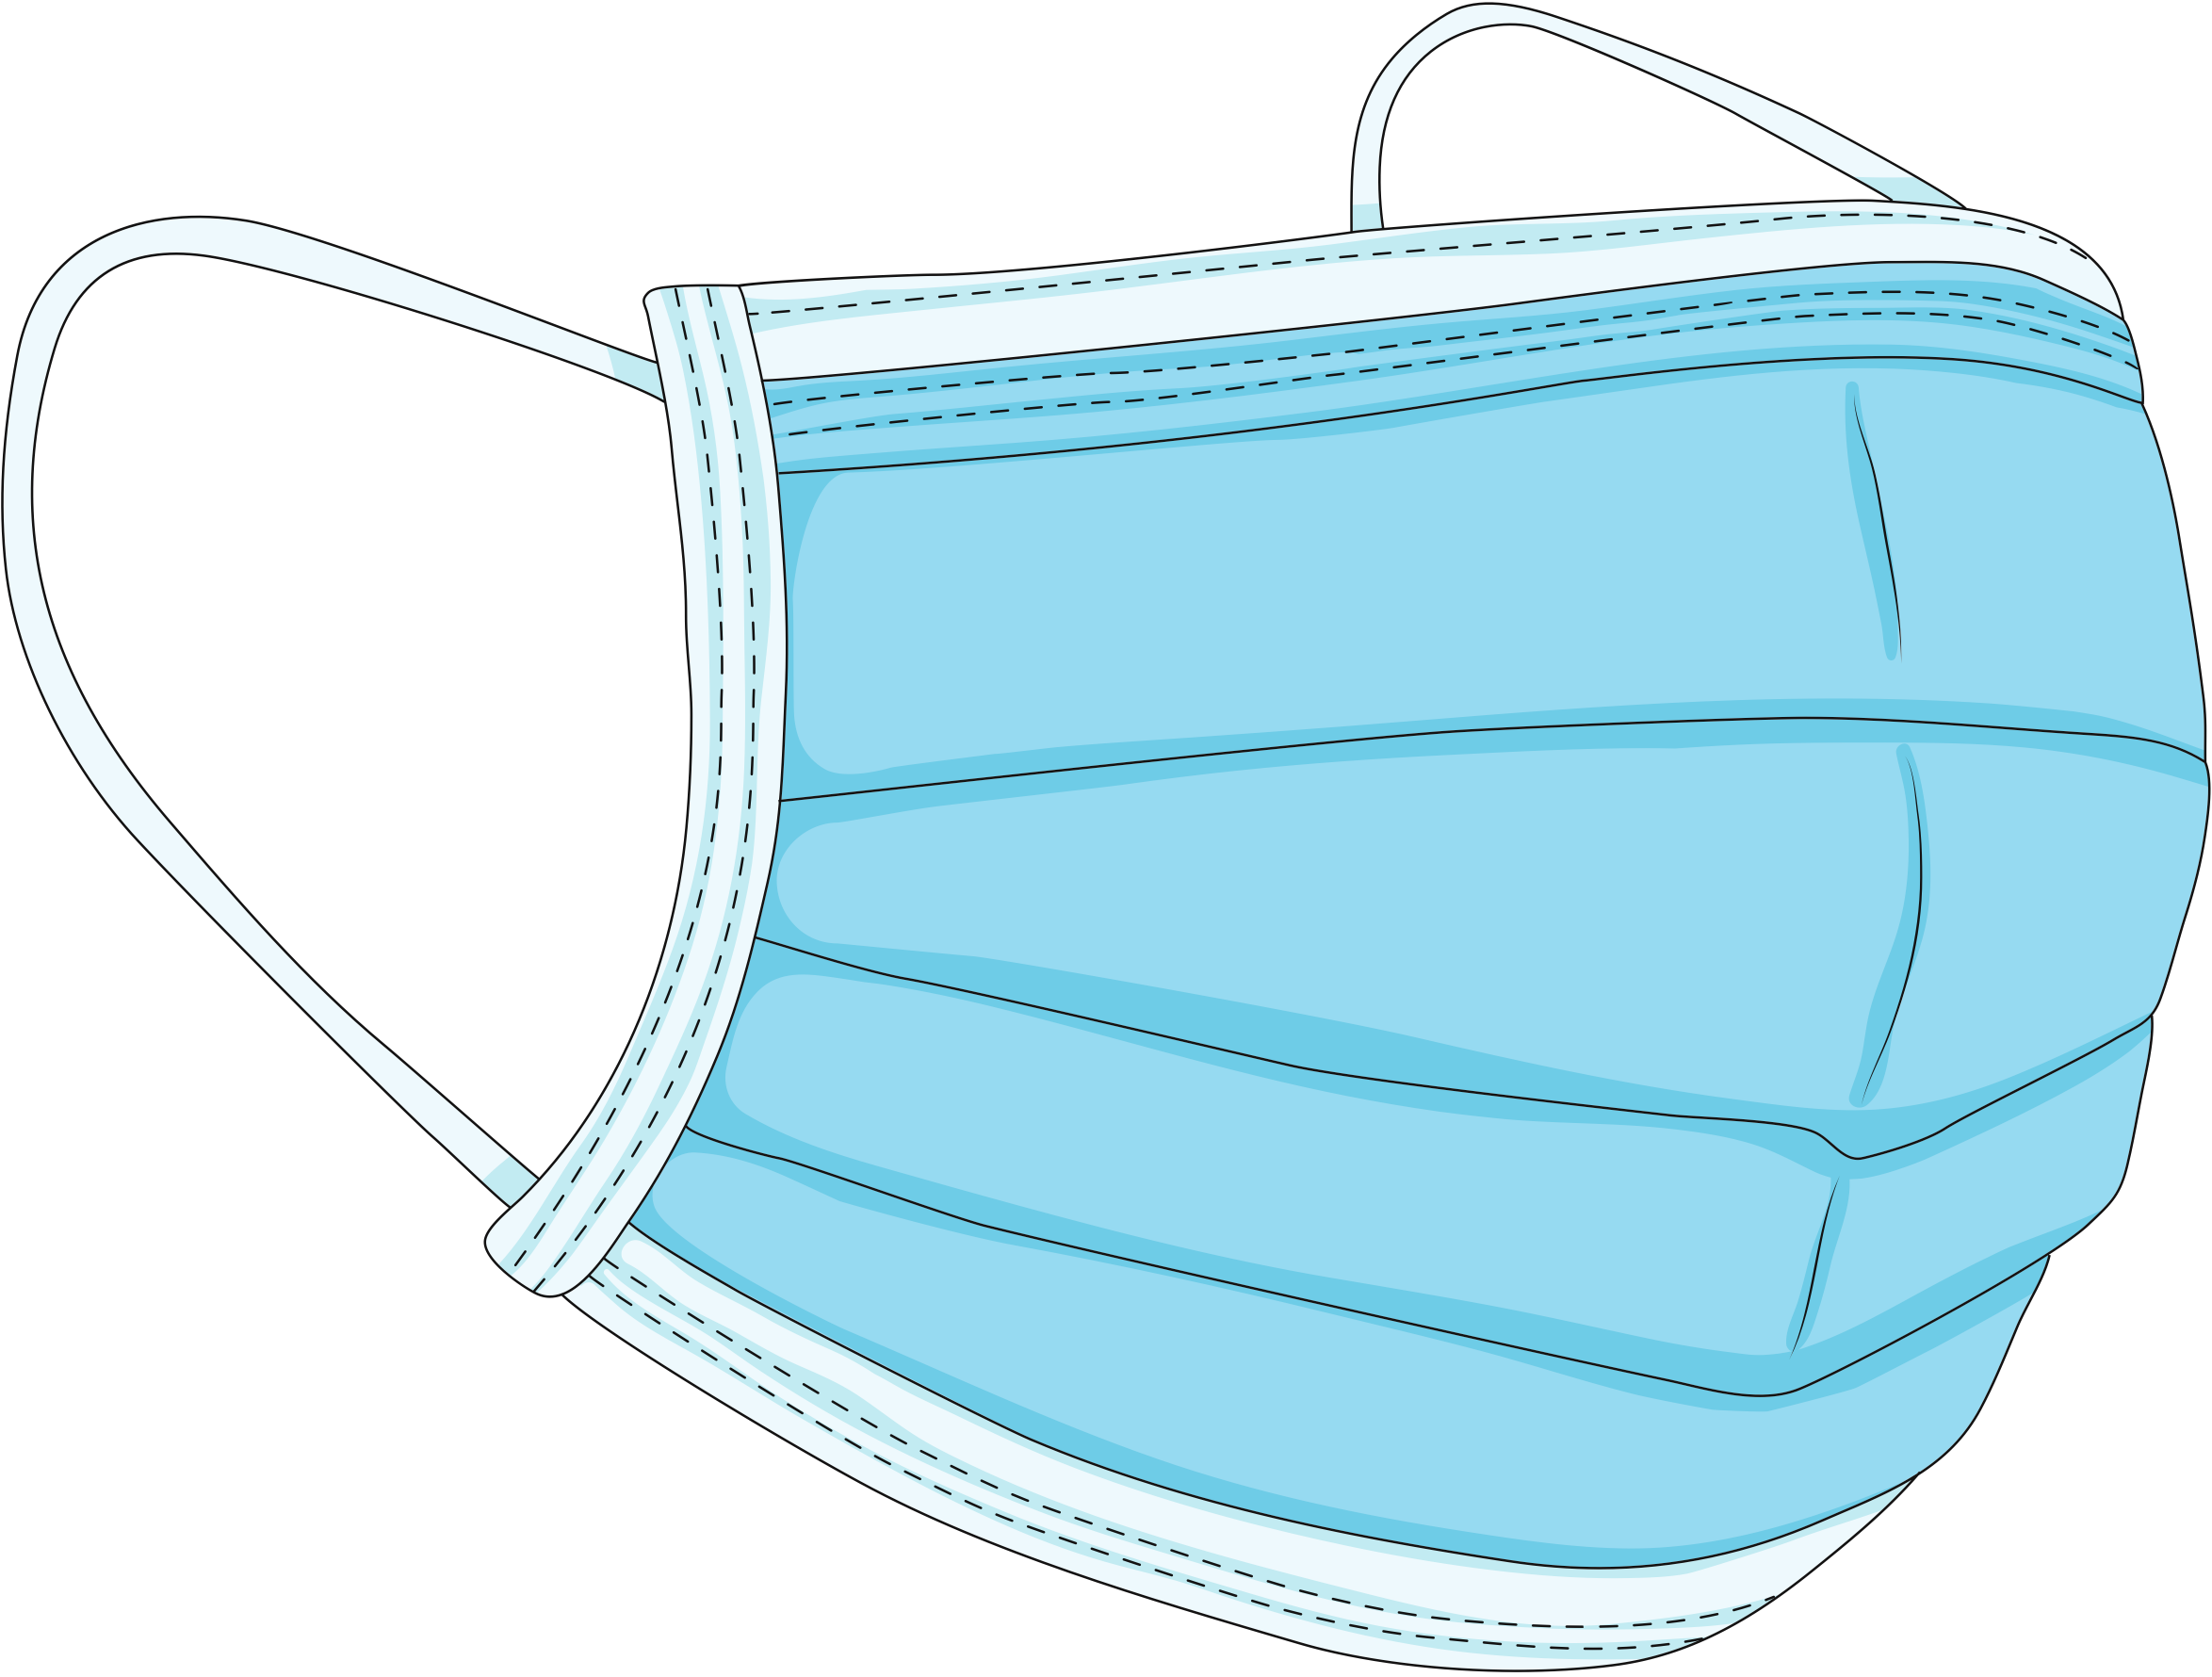
ADCQR 2025
Health professional attendances in the last 12 months – Type 1
 | Our site | Other similar sites
Endocrinologist | Insert % | Insert %
Diabetes Educator/ Nurse Practitioner | Insert % | Insert %
Dietitian | Insert % | Insert %
Podiatrist | Insert % | Insert %
Ophthalmologist | Insert % | Insert %
Optometrist | Insert % | Insert %
Psychologist/ Psychiatrist | Insert % | Insert %
Social worker | Insert % | Insert %
Dentist | Insert % | Insert %
Exercise physiologist/ Physiotherapist | Insert % | Insert %
Ambulance | Insert % | Insert %
Emergency Department | Insert % | Insert %
Please refer to page 39 of the site report

Slide 31
ADCQR 2025
Health professional attendances in the last 12 months – Type 2
 | Our site | Other similar sites
Endocrinologist | Insert % | Insert %
Diabetes Educator/ Nurse Practitioner | Insert % | Insert %
Dietitian | Insert % | Insert %
Podiatrist | Insert % | Insert %
Ophthalmologist | Insert % | Insert %
Optometrist | Insert % | Insert %
Psychologist/ Psychiatrist | Insert % | Insert %
Social worker | Insert % | Insert %
Dentist | Insert % | Insert %
Exercise physiologist/ Physiotherapist | Insert % | Insert %
Ambulance | Insert % | Insert %
Emergency Department | Insert % | Insert %
Please refer to page 40 of the site report

Slide 32


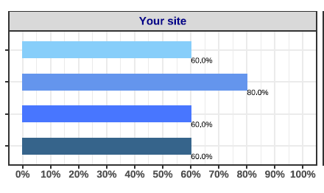

ADCQR 2025
Lifestyle – Type 1
Factors contributing to diet/nutrition management
Insert screenshot from
report that looks
similar to this graph, as
shown on page 40/41 of site report.
Delete this example picture and this red text before presenting.
Do not delete legend.
EXAMPLE ONLY
Please refer to page 41 of the site report

Slide 33
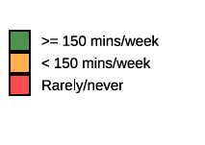
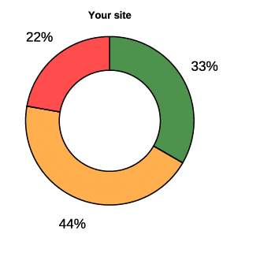
ADCQR 2025
Please refer to page 42 of the site report
Lifestyle – Type 1
Physical activity Recommended: ≥ 150 mins/week
Insert screenshot from
report that looks
similar to this graph, as
shown on page 40/41 of site report.
Delete this example picture and this red text before presenting.
Do not delete legend.
EXAMPLE ONLY
 | Our site | Other similar sites
Percentage doing muscle strengthening exercises | Insert % | Insert %

Slide 34
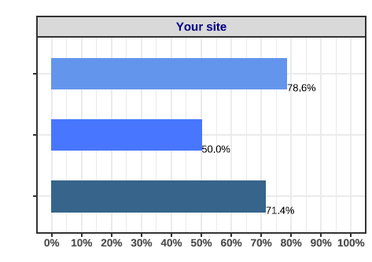

ADCQR 2025
Lifestyle – Type 2
Factors contributing to diet/nutrition management
Insert screenshot from
report that looks
similar to this graph, as
shown on page 40/41 of site report.
Delete this example picture and this red text before presenting.
Do not delete legend.
EXAMPLE ONLY
Please refer to page 42 of the site report

Slide 35
ADCQR 2025
Please refer to page 42 of the site report
Lifestyle – Type 2
Physical activity Recommended: ≥ 150 mins/week
Insert screenshot from
report that looks
similar to this graph, as
shown on page 40/41 of site report.
Delete this example picture and this red text before presenting.
Do not delete legend.
EXAMPLE ONLY
 | Our site | Other similar sites
Percentage doing muscle strengthening exercises | Insert % | Insert %

Slide 36
ADCQR 2025
Discussion and Quality Improvement (QI) plan
Edit as desired
Overall impression of results?
Room for improvement?
Are these:
a) Process measures (e.g., missing blood test results)?
b) Clinical outcomes (e.g., HbA1c)?

Slide 37
ADCQR 2025
Discussion and Quality Improvement (QI) plan
Develop a QI plan
1. What is your overall goal for your centre?
2. Assess your ADCQR data
3. Decide on a QI project (based on areas for improvement)
4. Plan your project
Are you measuring a process outcome (e.g. the proportion of people tested for HbA1c), or a clinical measure (e.g. HbA1c level)?
How will you measure this?
Who needs to do what action to help enable the goal?
What are your plans to review, test and refine your QI program?

Slide 38
ADCQR 2025
Thank you!
The ADCQR team thanks you for all your work in collecting this important clinical and benchmarking information.
We hope you find your site report and these slides helpful in understanding and sharing your data.

